Slide 1




Effect of Upstream Screens on Flow Unsteadiness in a Supersonic Wind Tunnel
Anna Gold
Mentor: Dr. James Threadgill
Arizona NASA Space Grant Symposium – Tempe, Arizona
April 19th, 2025

Slide 2
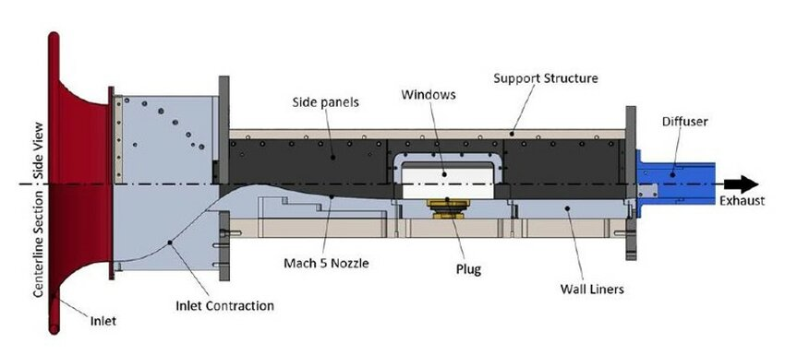
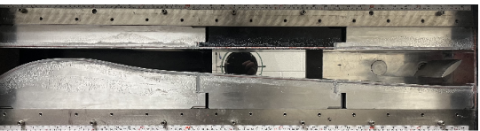
Introduction
The University of Arizona’s Indraft Supersonic Wind Tunnel (ISWT):
  Low-enthalpy, direct-connect testing
  Vacuum tank (34 m³): ~15 s of runtime every 15 min
  Mach 2.3, 4.0, 5.0
Source: researchgate.net

Slide 3
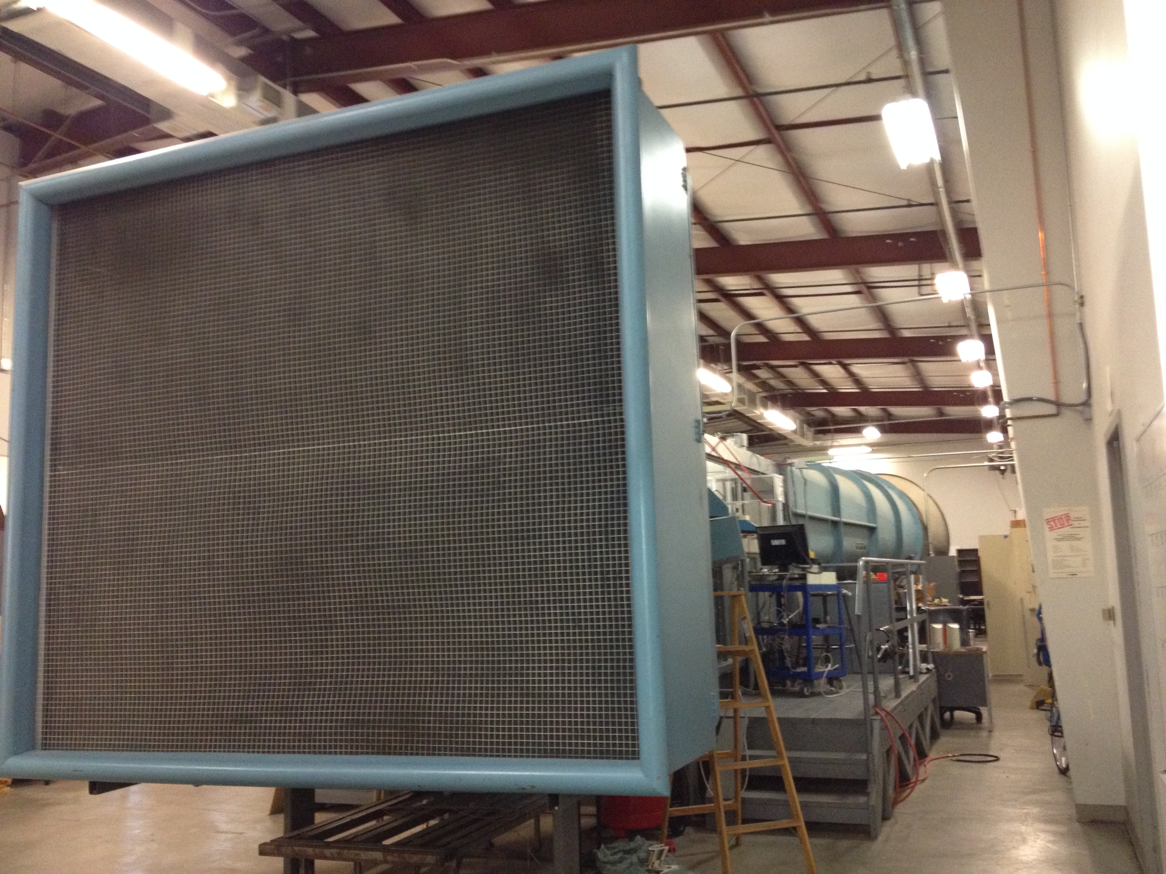
Problem Statement
Inlet disturbances affect downstream supersonic flow.
They cause non-uniform flow, turbulence, and shock instability.
Screens mitigate disturbances and enhance flow uniformity.
Source: flight.engr.ucdavis.edu

Slide 4
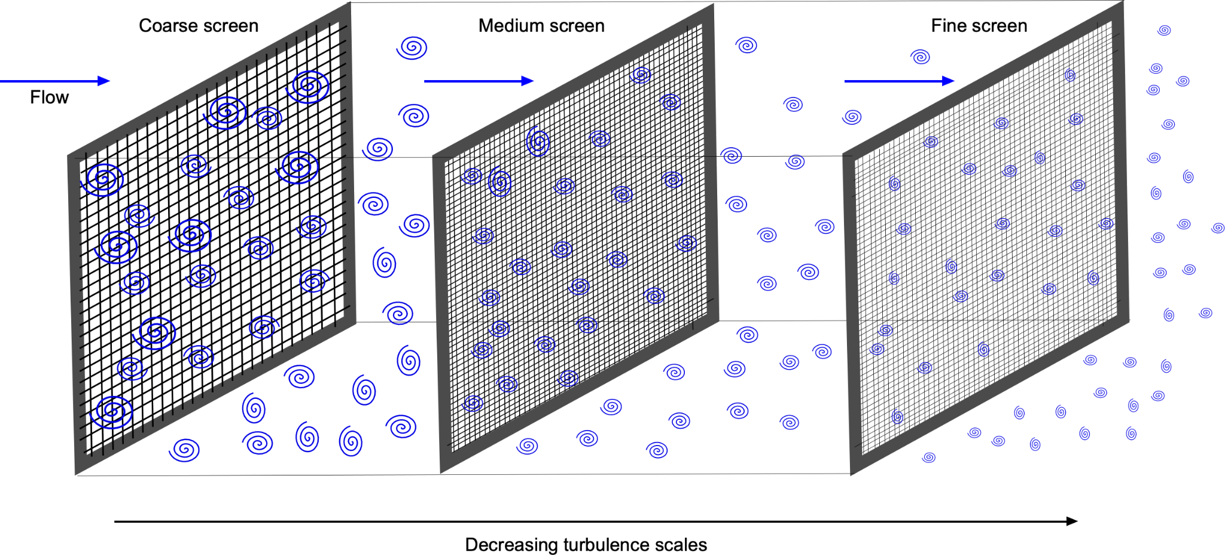
Wind Tunnel Screens
Screens upstream break down eddies to reduce turbulence.
They stabilize the boundary layer and supersonic flow.
Improve flow uniformity in the test section.
Source: eaglepubs.erau.edu

Slide 5
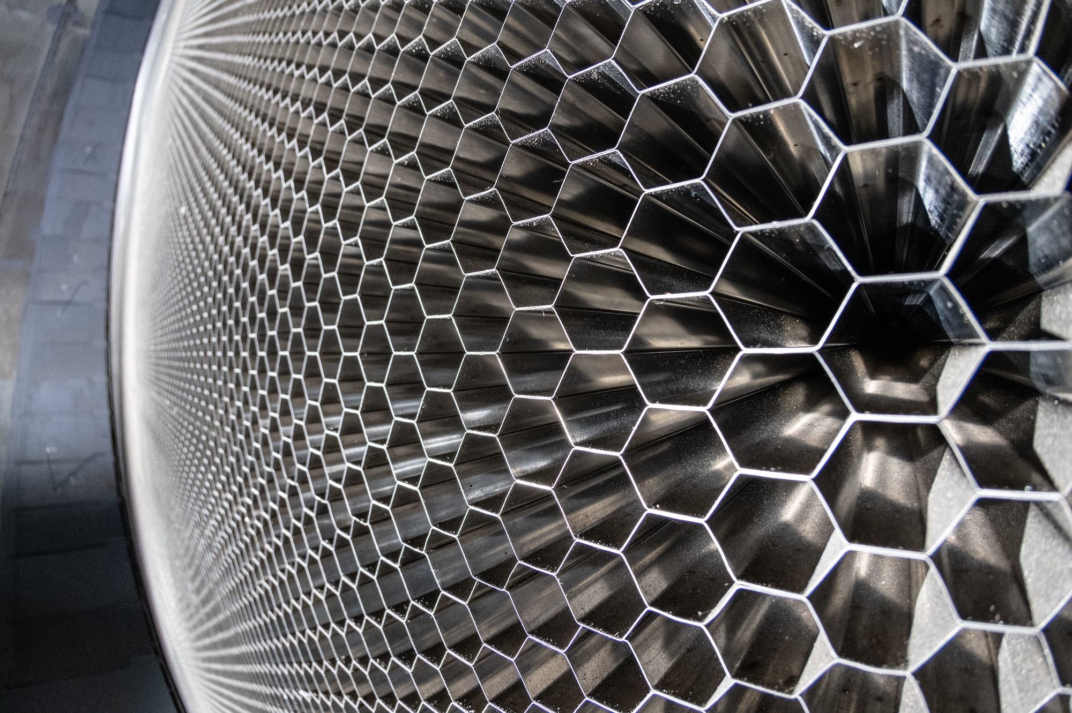
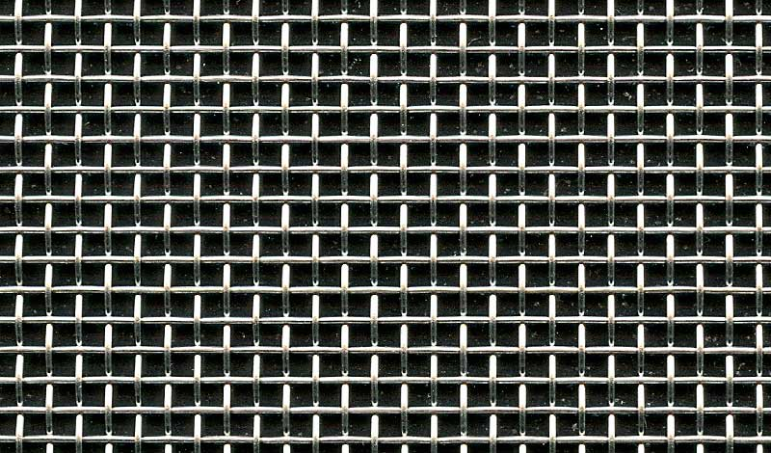
Honeycomb vs Mesh Screens
Honeycomb
Composed of hexagonal cells. 3D structure
Straightens the flow direction creating directional uniformity
Placed at inlet entrance far upstream
Higher open area ratio leads to low-pressure drop
Mesh
Woven material with regular pattern of openings and flat screen
Improves flow uniformity in terms of both velocity and turbulence
Can be layered to further reduce turbulence intensity
Higher pressure drop associated with lower open area ratios
Source: afmc.af.mil
Source: drahtweberei.de
Notes:
drahtweberei.de

Slide 6
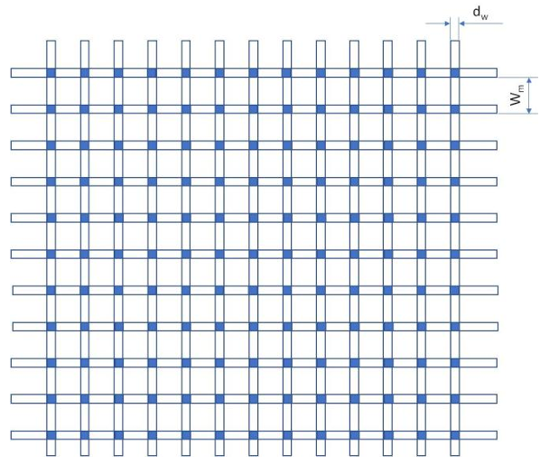

Screen Design Criteria
The screens effectiveness in reducing turbulence is strictly related to its porosity, which should be in the range between 0.58 – 0.8
$$β={\left(1−\frac{d}{L}\right)}^{2}$$
d = screen wire diameter
L = screen mesh length
Source: researchgate.net

Slide 7
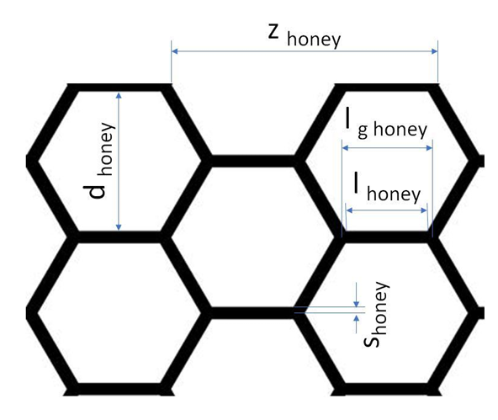
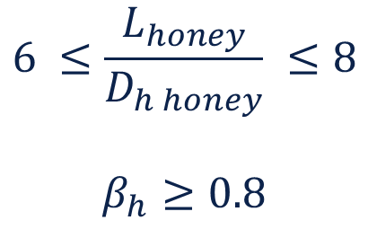
Screen Design Criteria
The honeycomb length and cell hydraulic diameter ratio must be in the range between 6 to 8 and the honeycomb porosity should be greater than 0.8
$$6 ≤\frac{L_{honey}}{D_{h honey}} ≤8$$
$$β_{h}≥0.8$$
L_{honey} = honeycomb length
D_{h honey} = honeycomb cell hydraulic diameter
Source: researchgate.net

Slide 8
Screen Sizing
ISWT cross-section is 122 x 406.4 mm
Appropriate mesh size
  D/20 ≤ 6.1mm, minimal turbulence control
  D/30 ≤ 4.067 mm, stronger turbulence control
    D = Smallest dimension of the wind tunnel (width or height)
Spacing between the screens = (0.2D to 0.5D) = 25 to 60 mm
Honeycomb cell sizes
  1/8" to 1/4": Best for high-precision flow straightening.
Source: researchgate.net

Slide 9
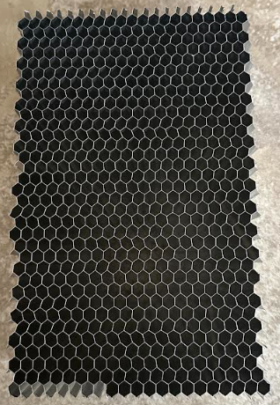
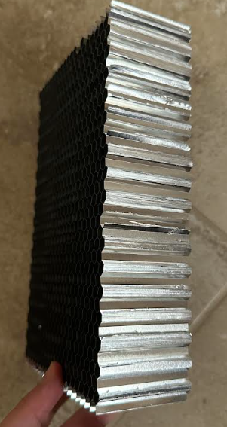
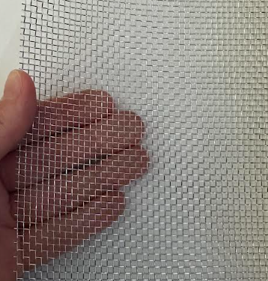
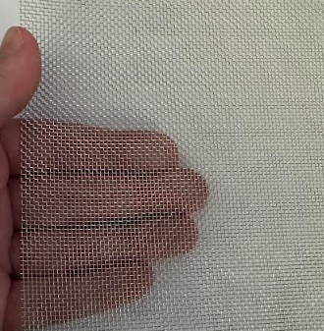
Screen Configuration
Honeycomb Screen
Thickness: 2” (50.8 mm)
Cell size: ¼” (6.35 mm)
Aspect Ratio: 8:1
Mesh Screen #1
d=0.45mm
l=2.00mm
𝛽=0.601
Mesh Screen #2
d=0.3mm
l=1.00mm
𝛽=0.52

Slide 10
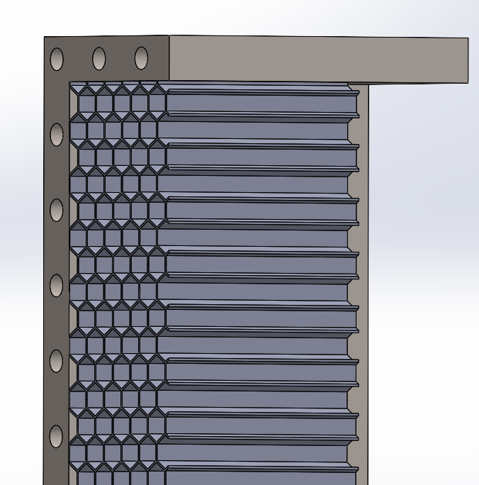
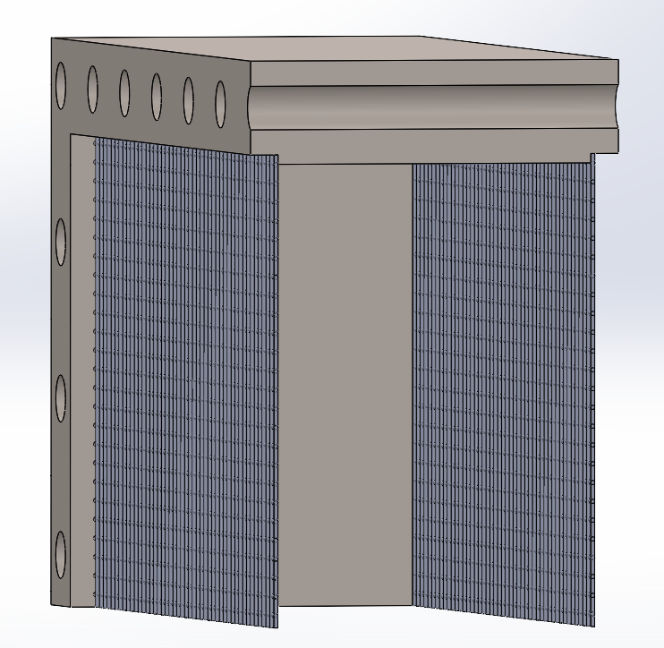
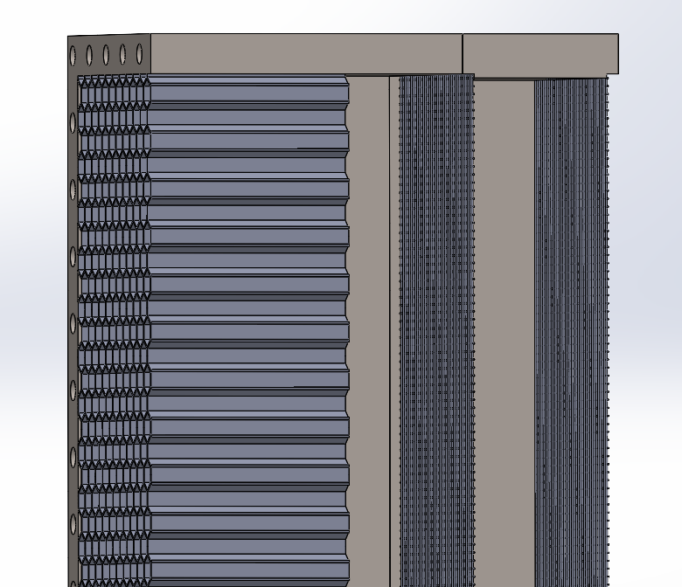
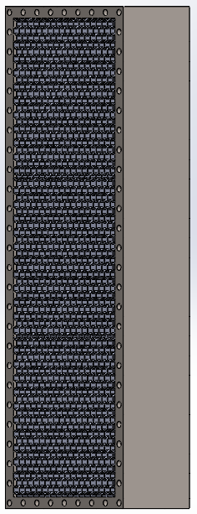
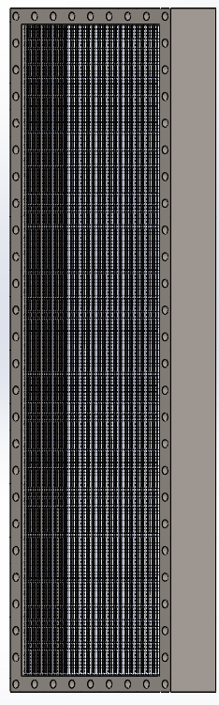
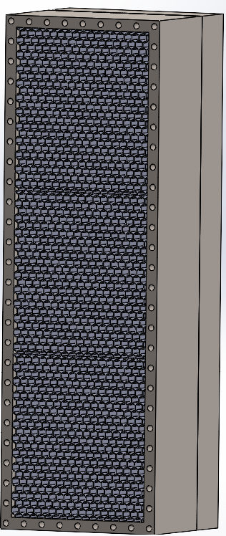
Screen Placement
Honeycomb
+
Mesh
Honeycomb
Mesh Screens

Slide 11
Next Steps
Test the pressure drop through the test section using a pitot probe
Analyze the effect that the screens have on flow unsteadiness
Determine the most efficient screen configuration for Mach 2.3, 4.0, 5.0

Slide 12
Acknowledgements
James Threadgill – Mentor
Roman Anthis – PhD Student
Glenn Berg – Master’s Student
Ashish Singh – Post-Doctoral Research Associate
Department of Aerospace and Mechanical Engineering

Slide 13
Thank you!

